Slide 1

A Seminar on
SUSPENSION & SLT
(Suspended load technique)
Under the supervision of
Sir Jitesh shukla
(assistant professor)
Presented by:- PRAKHAR SINGH
ME IIIB

Slide 2
CONTENT
INTRODUCTION OF SUSPENSION SYSTEM
HISTORY
FUNCTION OF SUSPENSION SYSTEM
REQUIREMENT OF SUSPENSION SYSTEM
ELEMENTS OF SUSPENSION SYSTEM

Slide 3
CONTENT
INTRODUCTION
SUSPENDED LOAD TECHNIQUE
PROBLEMS &NEED
DESIGN

Slide 4
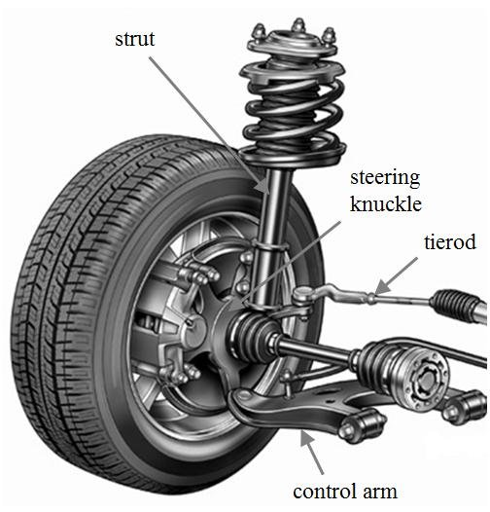
INTRODUCTION
The suspension system in automobile is one which separate wheel axel assembly from the body
The primary function of suspension is to isolate the vehicle structure from the shocks and vibration due to irregularities of the roads.

Slide 5
HISTORY
1903: Mors from Germany fitted a car with shock absorber.
1920: Layland used torsion bar in its suspension system.
1922: Unitary construction and independent front suspension were pioneered on the Lancia Lambda.

Slide 6
1932 :By this year ,the independent front suspension become more common in popular cars.
1948: Triumph Mayflower introduced the combined coil spring/damper unit.
1950: Ford adopted the McPherson strut independent front suspension on MK 1 consul.
1959 :Use of independent rubber suspension.
1962: Introduction of hydrostatic suspension.

Slide 7
Function of Suspension system
To prevent the road shocks from being transmitted to the vehicle frame.
To preserve the stability of the vehicle in pitching or rolling.
To safeguard the occupants from road shocks.
To provide good road holding while driving, cornering and braking.

Slide 8
Requirements
Low initial cost.
Minimum weight .
Minimum tyre wear.
Minimum deflection consistent with required stability.

Slide 9
Elements
Spring: It absorbs road shocks or impacts due to bump in road by oscillating. Tyres also provides spring effect , but to a smaller extent.
Damper :They reduce the tendency of the carriage unit to continue to “bounce” up and down on its springs. Oscillation due to road shocks are restricted to a reasonable level by damper.

Slide 10
SUSPENDED LOAD TECHNIQUE

Slide 11
INRODUCTION
A suspended-load backpack designed to permit the load to move relative to the wearer during walking and running so that the large movements between the load.
And the wearer of the backpack reduce the fluctuations of vertical motion of the load with respect to ground.
Because the hip (and thus the pack body) goes up a down a good deal during walking, a large relative movement between the wearer and the load reduces the absolute excursion of the load.
This movement may be, in turn, transferred to a motor through, for example, a rack and pinion gear, to convert t the mechanical movement to electrical or mechanical energy.

Slide 12
What is slt
HoverGlide consists of two frames with a sturdy elastic cable between them.
One frame containing the hipbelt and harness attaches to you as it would with a normal backpack.
The bag which carries the load is attached to the second frame. The second frame is attached to the first frame by a large elastic coupling

Slide 13
. As you walk, the frame attached to you moves up and down and the elastic cord gets stretched and shortens so that the frame with the bag attached stays at a constant height.
Slt is a technique which decrease strain force on the body.

Slide 14

.We can understand this principle by the video:-

Slide 15
PROBLEMS & NEEDS
difficult to move at high speeds with large loads
It may also contribute to the muscular and orthopedic injury suffered by those carrying heavy weights relative to their body mass.
Specially design for armed forces
By the technique slt you can move, run, jump with high loads.

Slide 16
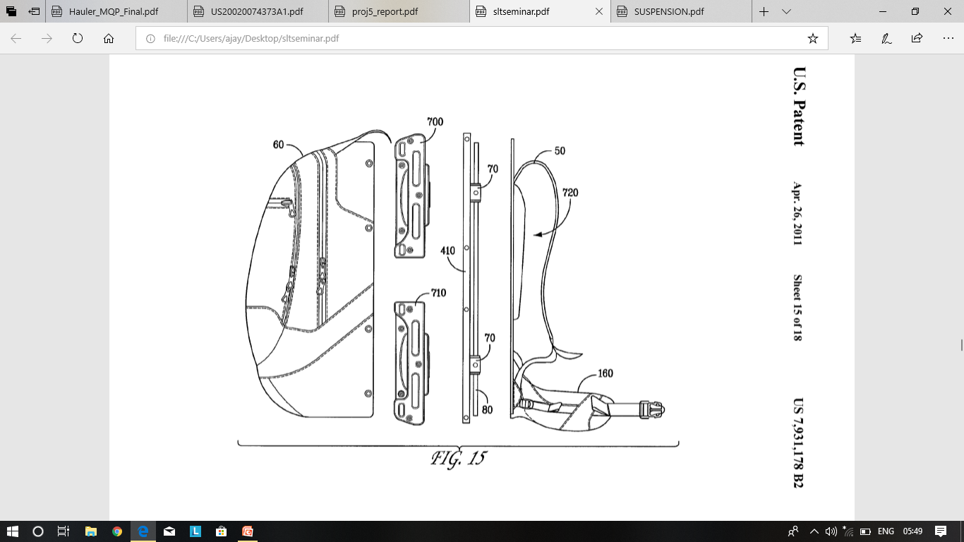
DESIGN
There are basically two frames.
At one frame load is attached

Slide 17
And second frame which have spring ,damper attached with first frame by large elastic coupling.
As you walk, the frame attached to you moves up and down and the elastic cord gets stretched and shortens so that the frame with the bag attached stays at a constant height

Slide 18
CONCLUSION
By using slt technique we get such a backpack in which we carry very heavy things but it feels light.
By using this ,mankind would save themselves with backinjuries
It is specially design for armed forces.

Slide 19
Thank you

